Slide 1
PHP Functions

Slide 2
PHP Functions
PHP function is a piece of code that can be reused many times.
It can take input as argument list and return value.
There are thousands of built-in functions in PHP that can be called directly, from within a script, to perform a specific task.
In PHP, we can define Conditional function, Function within Function and Recursive function also.

Slide 3
Advantage of PHP Functions
Code Reusability
Less Code
Easy to understand/
Duratio8:10
Loaded: 11.37%
Â

Slide 4
PHP User-defined Functions
Besides the built-in PHP functions, it is possible to create your own functions.
A function is a block of statements that can be used repeatedly in a program.
A function will not execute automatically when a page loads.
A function will be executed by a call to the function.

Slide 5
Create a User Defined Function in PHP
A user-defined function declaration starts with the word
function:
Syntax
function functionName() { code to be executed; }
A function name must start with a letter or an underscore.
Function names are NOT case-sensitive.

Slide 6
PHP Functions Example
keyword
<!DOCTYPE html>
<html>
<body>
<?php
function sayHello(){
echo "Hello PHP Function";
}
sayHello();//calling function
?>
</body>
</html>
Function name
Output:
Hello PHP Function
Code to be executed
Function call

Slide 7
PHP Function Arguments
Information can be passed to functions through arguments.
An argument is just like a variable.
Arguments are specified after the function name, inside the parentheses.
We can pass the information in PHP function through arguments which is separated by comma.
PHP supports Call by Value (default), Call by Reference, Default argument values and Variable-length argument list.

Slide 8
<!DOCTYPE html>
<html>
<body>
<?php
function sayHello($name){
echo "Hello $name<br/>";
}
sayHello("Sakshi");
sayHello("Divya");
sayHello("Dheeraj");
?>
</body>
</html>
Output:
Hello Sakshi Hello Divya Hello Dheeraj

Slide 9
The following example has a function with two arguments:
<!DOCTYPE html>
<html>
<body>
<?php
function sayHello($name,$age){
echo "Hello $name, you are $age years old<br/>";
}
sayHello("Sakshi",23);
sayHello("Divya",26);
sayHello("Dheeraj",32);
?>
</body>
</html>
Output:
Hello Sakshi, you are 23 years old Hello Divya, you are 26 years old Hello Dheeraj, you are 32 years old

Slide 10
PHP Call By Reference
Value passed to the function doesn't modify the actual value by default (call by value).
But we can do so by passing value as a reference.
By default, value passed to the function is call by value. To pass value as a reference, you need to use ampersand (&) symbol before the argument name.
Let's see a simple example of call by reference in PHP.

Slide 11
PHP Call By Reference
<?php
function adder(&$str2)
{
$str2 .= 'Call By Reference';
echo $str2;
}
$str = 'Hello ';
adder($str);
?>
Output:
Hello Call By Reference

Slide 12
<!DOCTYPE html>
<html>
<body>
<?php
function add_five(&$value) {
$value += 5;
}
$num = 2;
add_five($num);
echo $num;
?>
</body>
</html>
Output:
7

Slide 13
PHP Function: Default Argument Value
We can specify a default argument value in function.
While calling PHP function if you don't specify any argument, it will take the default argument.
Let's see a simple example of using default argument value in PHP function.

Slide 14
<!DOCTYPE html>
<html>
<body>
<?php
function sayHello($name="Rohit"){
echo "Hello $name<br/>";
}
sayHello("Ankur");
sayHello(); //passing no value
sayHello("Vishal");
?>
</body>
</html>
Output:
Hello Ankur Hello Rohit Hello Vishal

Slide 15
We did not have to tell PHP which data type the variable is.
PHP automatically associates a data type to the variable, depending on its value.
Since the data types are not set in a strict sense, you can do things like adding a string to an integer without causing an error.
In PHP 7, type declarations were added.
This gives us an option to specify the expected data type when declaring a function, and by adding the strict declaration, it will throw a "Fatal Error" if the data type mismatches.
In the following example we try to send both a number and a string to the function without using strict:

Slide 16
<?php
function addNumbers(int $a, int $b) {
return $a + $b;
}
echo addNumbers(5, "5 days");
// since strict is NOT enabled "5 days" is changed to int(5), and it will return 10
?>
Output:
10

Slide 17
<?php declare(strict_types=1); // strict requirement
function addNumbers(int $a, int $b) {
return $a + $b;
}
echo addNumbers(5, "5 days");
// since strict is enabled and "5 days" is not an integer, an error will be thrown
?>
PHP Fatal error: Uncaught TypeError: Argument 2 passed to addNumbers() must be of the type integer, string given, called in /home/bWN0Ml/prog.php on line 6 and defined in /home/bWN0Ml/prog.php:3 Stack trace: #0 /home/bWN0Ml/prog.php(6): addNumbers(5, '5 days') #1 {main} thrown in /home/bWN0Ml/prog.php on line 3

Slide 18
PHP Functions - Returning values
To let a function return a value, use the return statement:
<?php declare(strict_types=1); // strict requirement ?>
<!DOCTYPE html>
<html>
<body>
<?php
function sum(int $x, int $y) {
$z = $x + $y;
return $z;
}
echo "5 + 10 = " . sum(5,10) . "<br>";
echo "7 + 13 = " . sum(7,13) . "<br>";
echo "2 + 4 = " . sum(2,4);
?>
</body>
</html>
Output:
5 + 10 = 15 7 + 13 = 20 2 + 4 = 6

Slide 19
PHP Return Type Declarations
PHP 7 also supports Type Declarations for the return statement.
Like with the type declaration for function arguments, by enabling the strict requirement, it will throw a "Fatal Error" on a type mismatch.
To declare a type for the function return, add a colon ( : ) and the type right before the opening curly ( { )bracket when declaring the function.

Slide 20
<?php declare(strict_types=1); // strict requirement
function addNumbers(float $a, float $b) : float {
return $a + $b;
}
echo addNumbers(1.2, 5.2);
?>
Output:
6.4
<?php declare(strict_types=1); // strict requirement
function addNumbers(float $a, float $b) : int {
return (int)($a + $b);
}
echo addNumbers(1.2, 5.2);
?>
Output:
6

Slide 21
PHP Variable Length Argument Function
PHP supports variable length argument function.
It means you can pass 0, 1 or n number of arguments in function.
To do so, you need to use 3 ellipses (dots) before the argument name.
The 3 dot concept is implemented for variable length argument since PHP 5.6.
Let's see a simple example of PHP variable length argument function.

Slide 22
<?php
function add(...$numbers) {
$sum = 0;
foreach ($numbers as $n) {
$sum += $n;
}
return $sum;
}
echo add(1, 2, 3, 4);
?>
Output:
10

Slide 23
PHP include and require Statements
.
Both require() and include() Functions are utilized to add the external PHP files in the current PHP script.
The include (or require) statement takes all the text/code/markup that exists in the specified file and copies it into the file that uses the include statement.
Including files is very useful when you want to include the same PHP, HTML, or text on multiple pages of a website.
With this, both functions enhance the code reusability, along with breaking down large applications into smaller, more manageable parts.
Including files saves a lot of work. This means that you can create a standard header, footer, or menu file for all your web pages.
Then, when the header needs to be updated, you can only update the header include file.

Slide 24
Syntax
include 'filename'; or require 'filename';

Slide 25
PHP include() Function
The include() function in PHP is basically used to include the contents/code/data of one PHP file to another PHP file.
During this process if there are any kind of errors then this include() function will pop up a warning, it will not stop the execution of the script rather the script will continue its process.
In order to use this include() function, we will first need to create two PHP files.
Using the include() function, include one PHP file into another one.
After that, you will see two PHP files combined into one HTML file.

Slide 26
PHP include Examples
Assume we have a standard footer file called "footer.php", that looks like this:
<?php echo "<p>Copyright &copy; 1999-" . date("Y") . “ www.glauniversity.ac.in</p>"; ?>
To include the footer file in a page, use the include statement:

Slide 27
<!DOCTYPE html>
<html lang="en">
<head>
<meta charset="UTF-8">
<meta name="viewport" content="width=device-width, initial-scale=1.0">
<title>Document</title>
</head>
<body>
<h1>Welcome to GLA University</h1>
<p>About GLA </p>
<p>Some more text.</p>
<?php include 'footer.php';?>
</body>
</html>
include.php

Slide 28
<?php
echo "<address> GLA UNIVERSITY<br>
17km Stone, NH-19,<br>
Mathura-Delhi Road<br>
P.O. Chaumuhan,<br>
Mathura-281 406 (U.P.) India</address>";
echo "<p> Contact Us<br>
+91-5662-250900,<br>
250909, 241489,<br>
+91-9927064017</p>";
echo "<p>Email: glauniversity@gla.ac.in</p>";
?>
footer.php

Slide 29

Output
when footer.php found

Slide 30
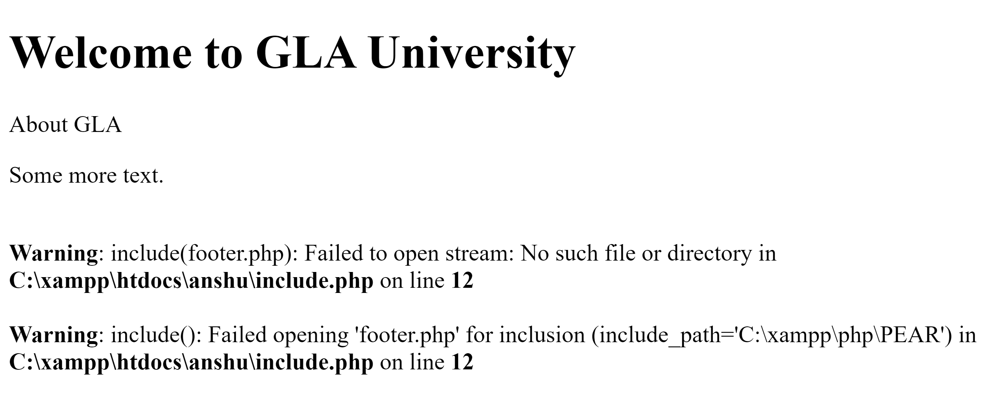
Output
when footer.php NOT found

Slide 31
PHP require() Function
The require() function in PHP is basically used to include the contents/code/data of one PHP file to another PHP file.
During this process, if there are any kind of errors then this require() function will pop up a warning along with a fatal error and it will immediately stop the execution of the script.
In order to use this require() function, we will first need to create two PHP files.
Using the require() function, include one PHP file into another one.
After that, you will see two PHP files combined into one HTML file.

Slide 32
<!DOCTYPE html>
<html lang="en">
<head>
<meta charset="UTF-8">
<meta name="viewport" content="width=device-width, initial-scale=1.0">
<title>Document</title>
</head>
<body>
<h1>Welcome to GLA University</h1>
<p>About GLA </p>
<p>Some more text.</p>
<?php require 'footer.php';?>
</body>
</html>
require.php

Slide 33
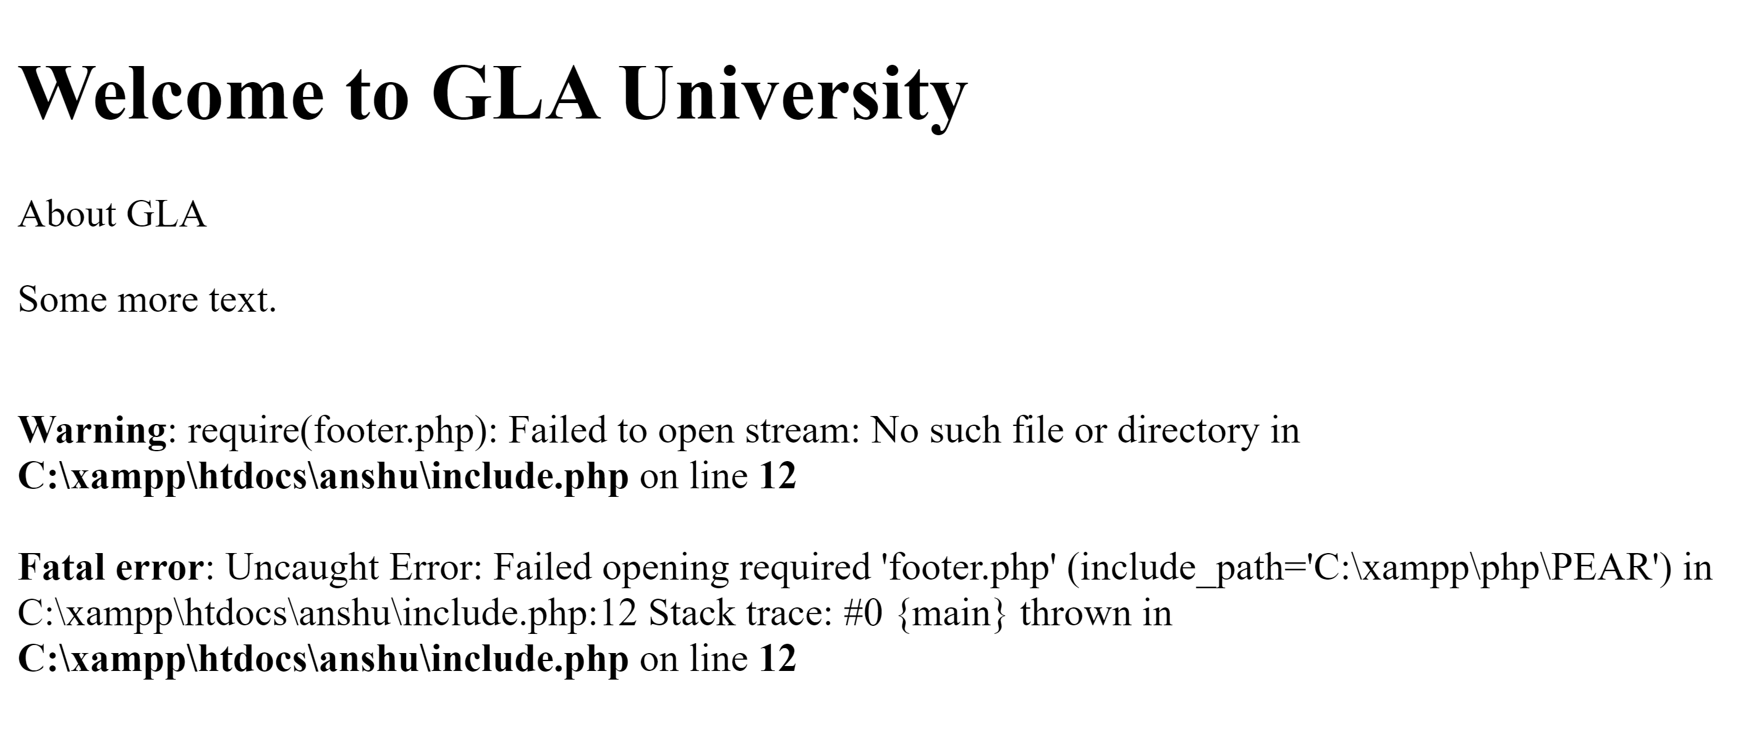
Output
when footer.php NOT found

Slide 34
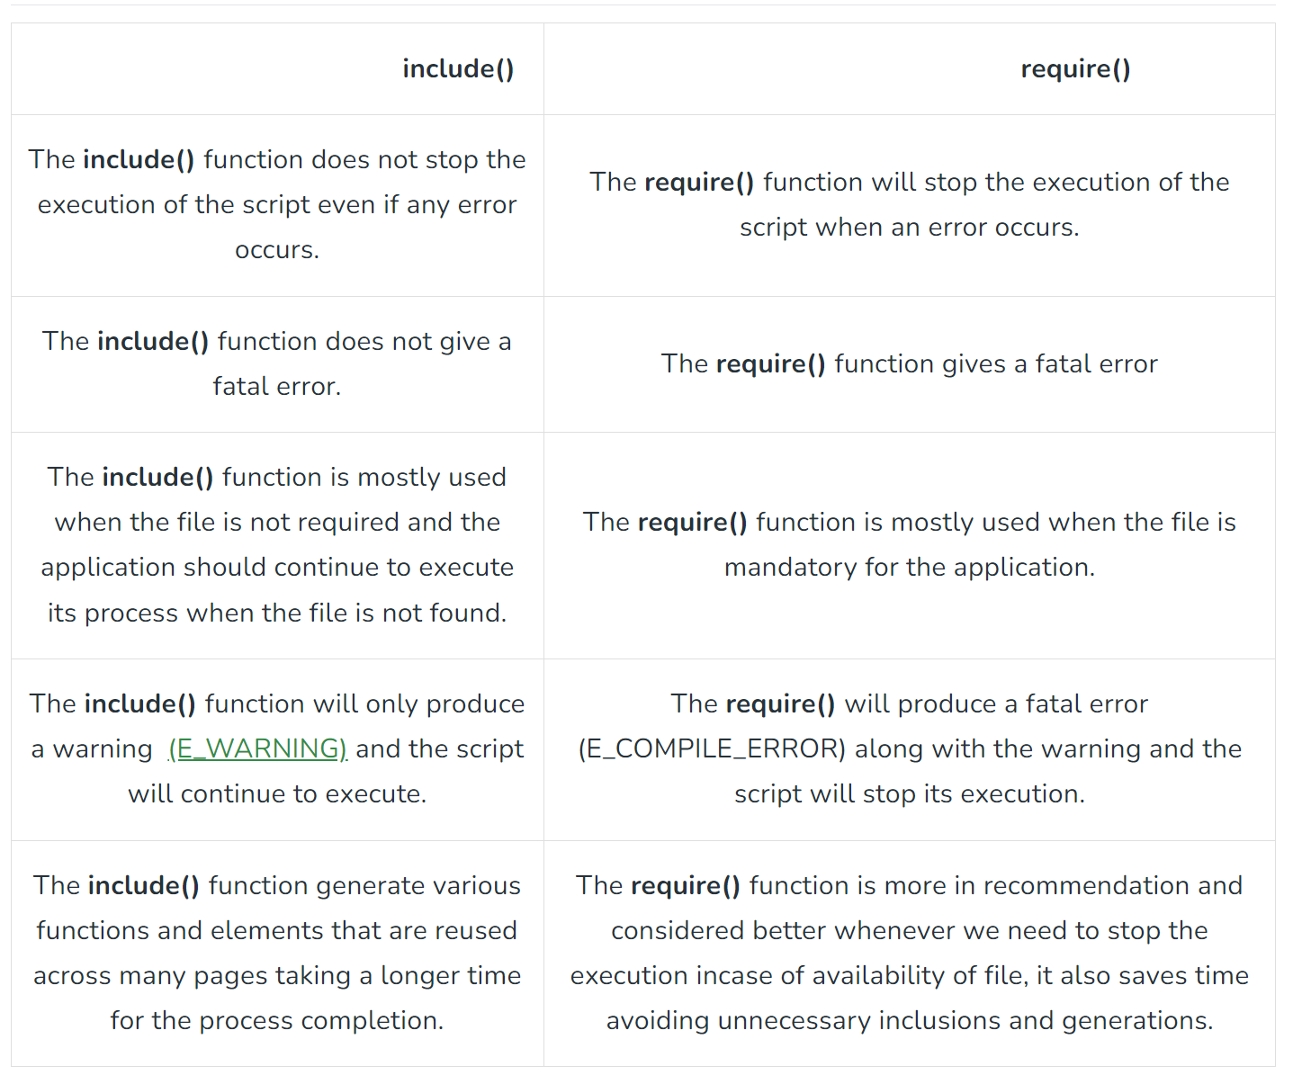
Difference between require() and include() Functions

Slide 35
PHP isset() Function
The isset() function checks whether a variable is set, which means that it has to be declared and is not NULL.
This function returns true if the variable exists and is not NULL, otherwise it returns false.
If multiple variables are supplied, then this function will return true only if all of the variables are set.

Slide 36
Example: Check whether a variable is empty. Also check whether the variable is set/declared:
<!DOCTYPE html>
<html>
<body>
<?php
$a = 0;
// True because $a is set
if (isset($a)) {
echo "Variable 'a' is set.<br>";
}
$b = null;
// False because $b is NULL
if (isset($b)) {
echo "Variable 'b' is set.";
}
?>
</body>
</html>
Output:
Variable 'a' is set.

Slide 37
PHP unset() Function
The unset() function unsets a variable.
Syntax
unset(variable, ....);

Slide 38
<!DOCTYPE html>
<html>
<body>
<?php
$a = "Hello world!";
echo "The value of variable 'a' before unset: " . $a . "<br>";
unset($a);
echo "The value of variable 'a' after unset: " . $a;
?>
</body>
</html>
Output:
The value of variable 'a' before unset: Hello world! The value of variable 'a' after unset:

